Slide 1
Online price data, high frequency inflation measures, and formulation of monetary policy in New Zealand
UNCLASSIFIED
Karsten Chipeniuk
Reserve Bank of New Zealand
14 May 2024
Joint work with Alan Bentley and Frances Krsinich. Special thanks to Christopher Ball, Lucas Chen, Lydia Dudson and Marea Sing. The views expressed are those of the presenter and do not necessarily reflect the views of the Reserve Bank of New Zealand or StatsNZ.
unclassified

Slide 2
Motivation
  CPI data is released quarterly in New Zealand.
      Most national statistical offices release monthly data.
      Some monthly series in NZ (e.g. specific price indexes).
      Ongoing challenges to produce a monthly series in NZ.
  Monetary policy decisions are made 7 times per year.
      Four monetary policy statements.
      Three monetary policy reviews.
  High frequency, granular price data increasingly available.
      Web-scraped data.
      Scanner data.
unclassified

Slide 3
Research Question
  Can high-frequency, granular, web-scraped price data be used to better understand the inflation process in real-time?
      The price setting process?
      High frequency indicators?
unclassified

Slide 4
What We Do
  Investigate use of daily web-scraped data.
  Explore features of the data.
      Sectoral coverage.
      Summary statistics.
  Investigate the construction of high frequency indicators for inflation.
      Using machine learning (XGBoost).
      Pseudo out-of-sample nowcasting exercise.
unclassified

Slide 5
Related Literature.
  Early literature on online prices found similarities to offline prices.
      Brynjolfsson and Smith (2000)
      Clay, Ramayya, Wolff, and Fernandes (2002)
      Cavallo, Neiman, and Rigobon (2014)
      Cavallo, Neiman, and Rigobon (2015)
  Recent attempts to gather large data sets.
      Cavallo and Rigobon (2016)
      Cavallo (2017)
unclassified

Slide 6
Related Literature.
  Use of online prices to measure inflation.
      Cavallo (2013) – Argentina.
      Harchaoui and Janssen (2018) – US.
      Osbat (2022) – EU.
      Jaworski (2021) – Poland.
  Use by national statistical offices.
      Breton, Clews, Metcalfe, Milliken, Payne, Winton, and Woods (2015) - UK
      Horrigan (2013) – US.
      Krsinich (2015) – NZ.
      Nygard (2015) – Norway.
unclassified

Slide 7
Related Literature.
  Nowcasting and forecasting.
      Aparicio and Bertolotto (2020) – forecasting inflation.
      Marcias, Stelmasiak, and Szafranek (2023) – nowcasting food price inflation.
  Machine learning.
      Almosova and Andresen (2023) – neural networks to forecast inflation.
      Qureshi, Chu, and Demers (2020) – XGBoost to forecast GDP.
  In New Zealand.
      Krsinich (2015) – FEWS index.
      Bentley and Krsinich (2017) – high level.
      Lynch, Olivecrona, and Stansfield (2019) – online indices.
      Stansfield and Krsinich (2021) – novel price data.
unclassified

Slide 8
Data
  Web-scraped prices.
      Daily frequency.
      Beginning 1 January 2014.
      Ending 25 September 2022.
      Price, product identifier, retailer, date, COICOP category.
      14 online retailers.
unclassified

Slide 9
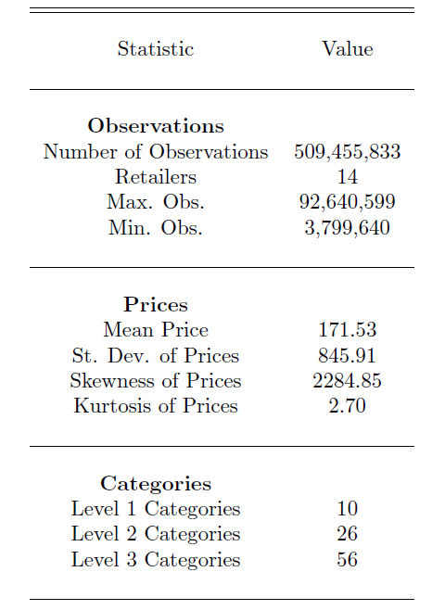
Summary Statistics
unclassified

Slide 10
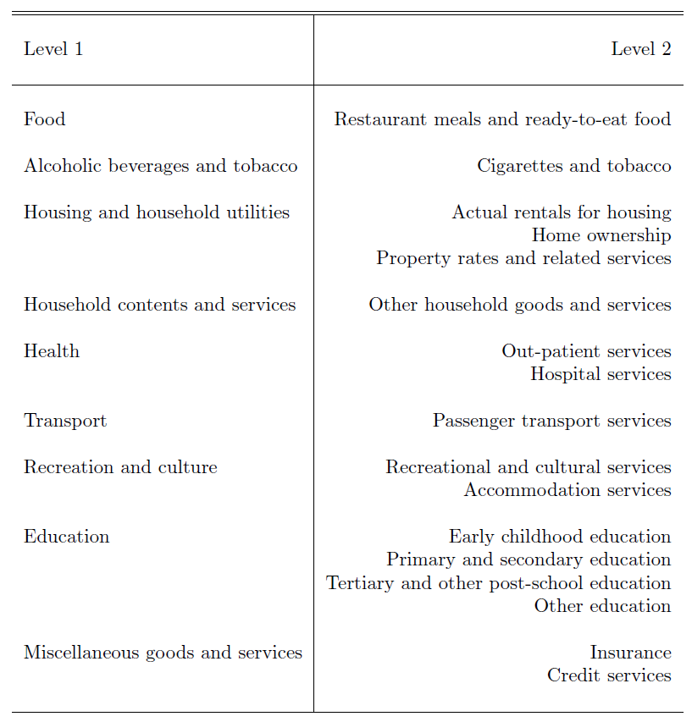
Missing Categories
unclassified

Slide 11
Challenges
  No quantities.
      Unable to use the data to construct basket weights.
      Contrast with scanner data.
  Final price may differ from the advertised price.
      Prices with and without sales are included.
      But inconsistently reported.
  Missing or noisy data.
      Retailers enter and exit at different times.
      Some enter and exit multiple times.
  Data set size.
      Data for a single retailer ~15GB.
unclassified

Slide 12
Methodology
  Priorities.
      Work with prices from all retailers simultaneously.
      Retain high frequency.
      Retain at least some classification.
  Aggregate prices.
      Within level 2 COICOP categories.
      On each date.
      Across retailers.
  Number of observations = #(level 2 categories) times #(dates)
      63,800 values.
unclassified

Slide 13
Methodology
  Use aggregates as features with XGBoost.
      “Extreme Gradient Boosting”.
      Popular machine learning algorithm.
      Introduced in 2014.
  Can learn nonlinear relationships.
      Between input data and a target variable.
      By combining outputs of primitive nonlinear objects.
  Algorithm.
      Combines predictions of several decision trees.
      Adds trees one by one to minimize errors made by previous ones.
      Uses gradient descent to perform the minimization.
unclassified

Slide 14
Methodology
  Pseudo out-of-sample nowcasting exercise.
      Collect observations of categorical price averages.
      According to quarter in which date falls.
      1,800-1,840 features depending on quarter.
      Treat the extra 20-40 features as unobserved in quarters with 91 or 90 days.
      Predicted variable: YoY CPI percentage inflation rate.
  Expanding window.
      Train the model initially on first 16 CPI observations.
      Proceed quarter by quarter.
        Add new price aggregates from data.
        Predict that quarter’s CPI outturn.
        Compute the absolute error between prediction and observation.
        Add this data to the training set.
unclassified

Slide 15
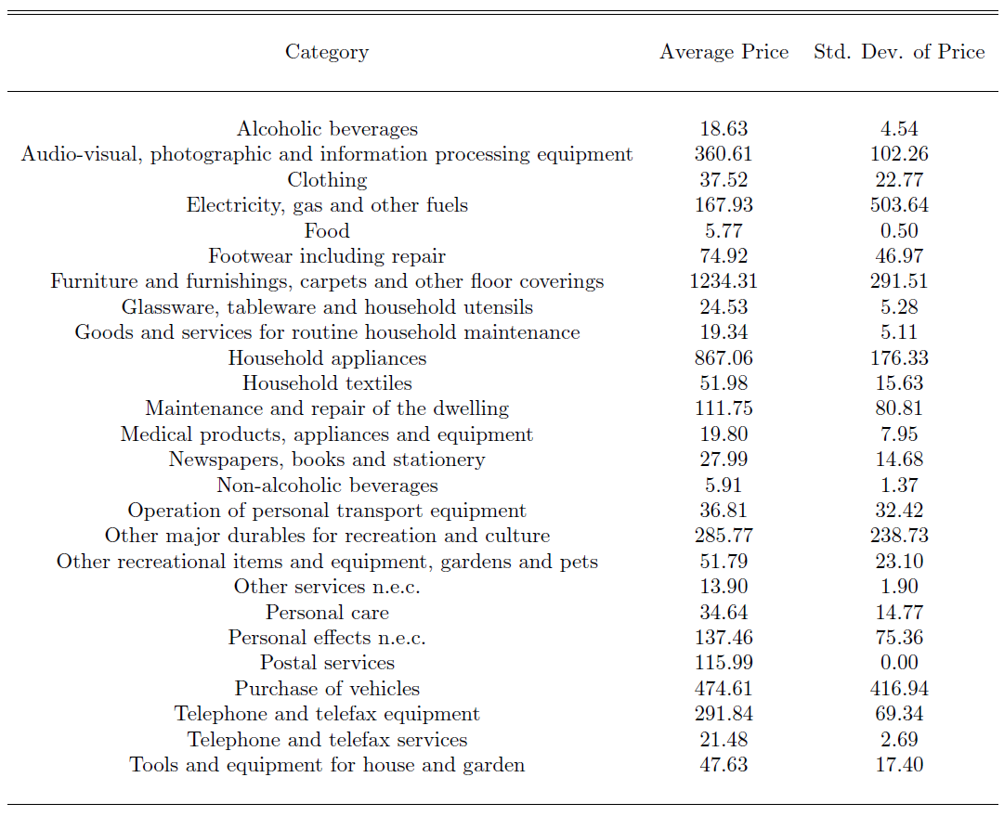
Results – Price Aggregate Stats
unclassified

Slide 16
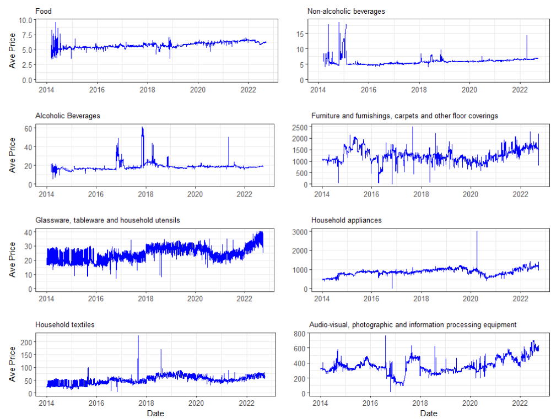
Results – Price Aggregate Plots
unclassified

Slide 17
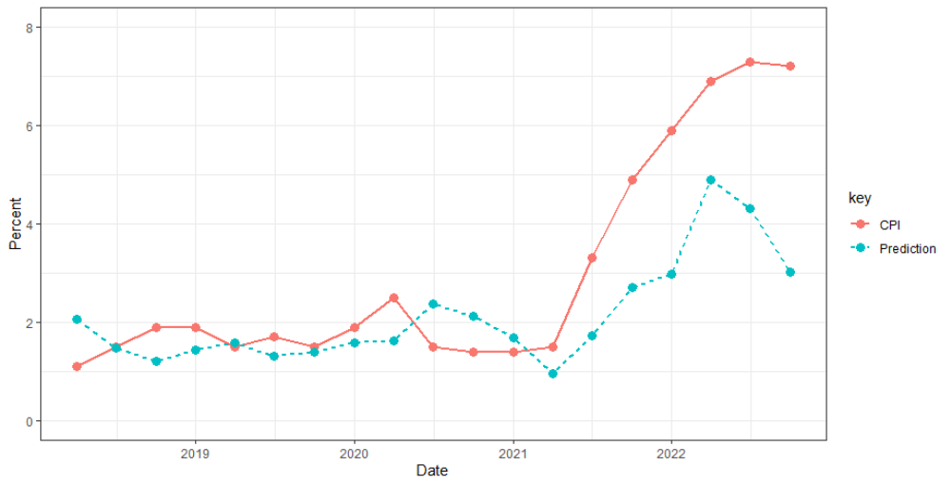
Results – XGBoost Predictions
unclassified

Slide 18
Results – Potential Issues
  Data set does not include a period of high inflation.
  COVID inflation was initially driven by supply side factors
      Shipping
      Petrol prices
  Current data set does not include services.
      E.g., housing and rents.
unclassified

Slide 19
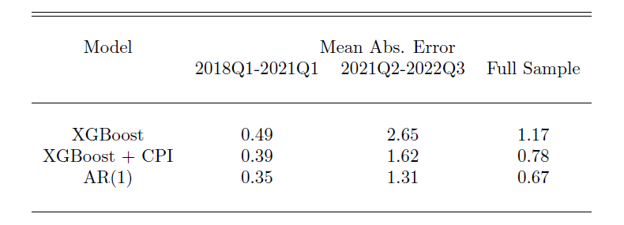
Results – XGBoost Predictions
unclassified

Slide 20
Potential Extensions
  Further examination of micro-price adjustment phenomena.
  Assess now/fore-casting performance with other inflation indexes.
      Non-tradables.
      Sector-specific.
  Add additional data to the set.
      Petrol prices.
      Tenancy bond data.
  Other feature engineering.
      E.g. average over COICOP level 3.
  Feature prioritization.
  Hyperparameter tuning.
  Daily/monthly predictors.
      Conditional on finding something reliable.
unclassified

Slide 21
Summary
  Daily, granular online price data.
      Large potential.
      Equally large challenges.
  Data coverage of goods categories.
      Decent for goods.
      Lacks some key goods and most services.
  Able to observe interesting micro price setting behavior.
  Pseudo out of sample nowcasting exercise.
      Using aggregated features with XGBoost.
      Initial results promising…
      …but not yet something we can operationalize.
      Many potential extensions.
unclassified

